Slide 1

Speak fluently
Intermediate

Slide 2
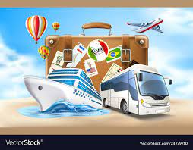
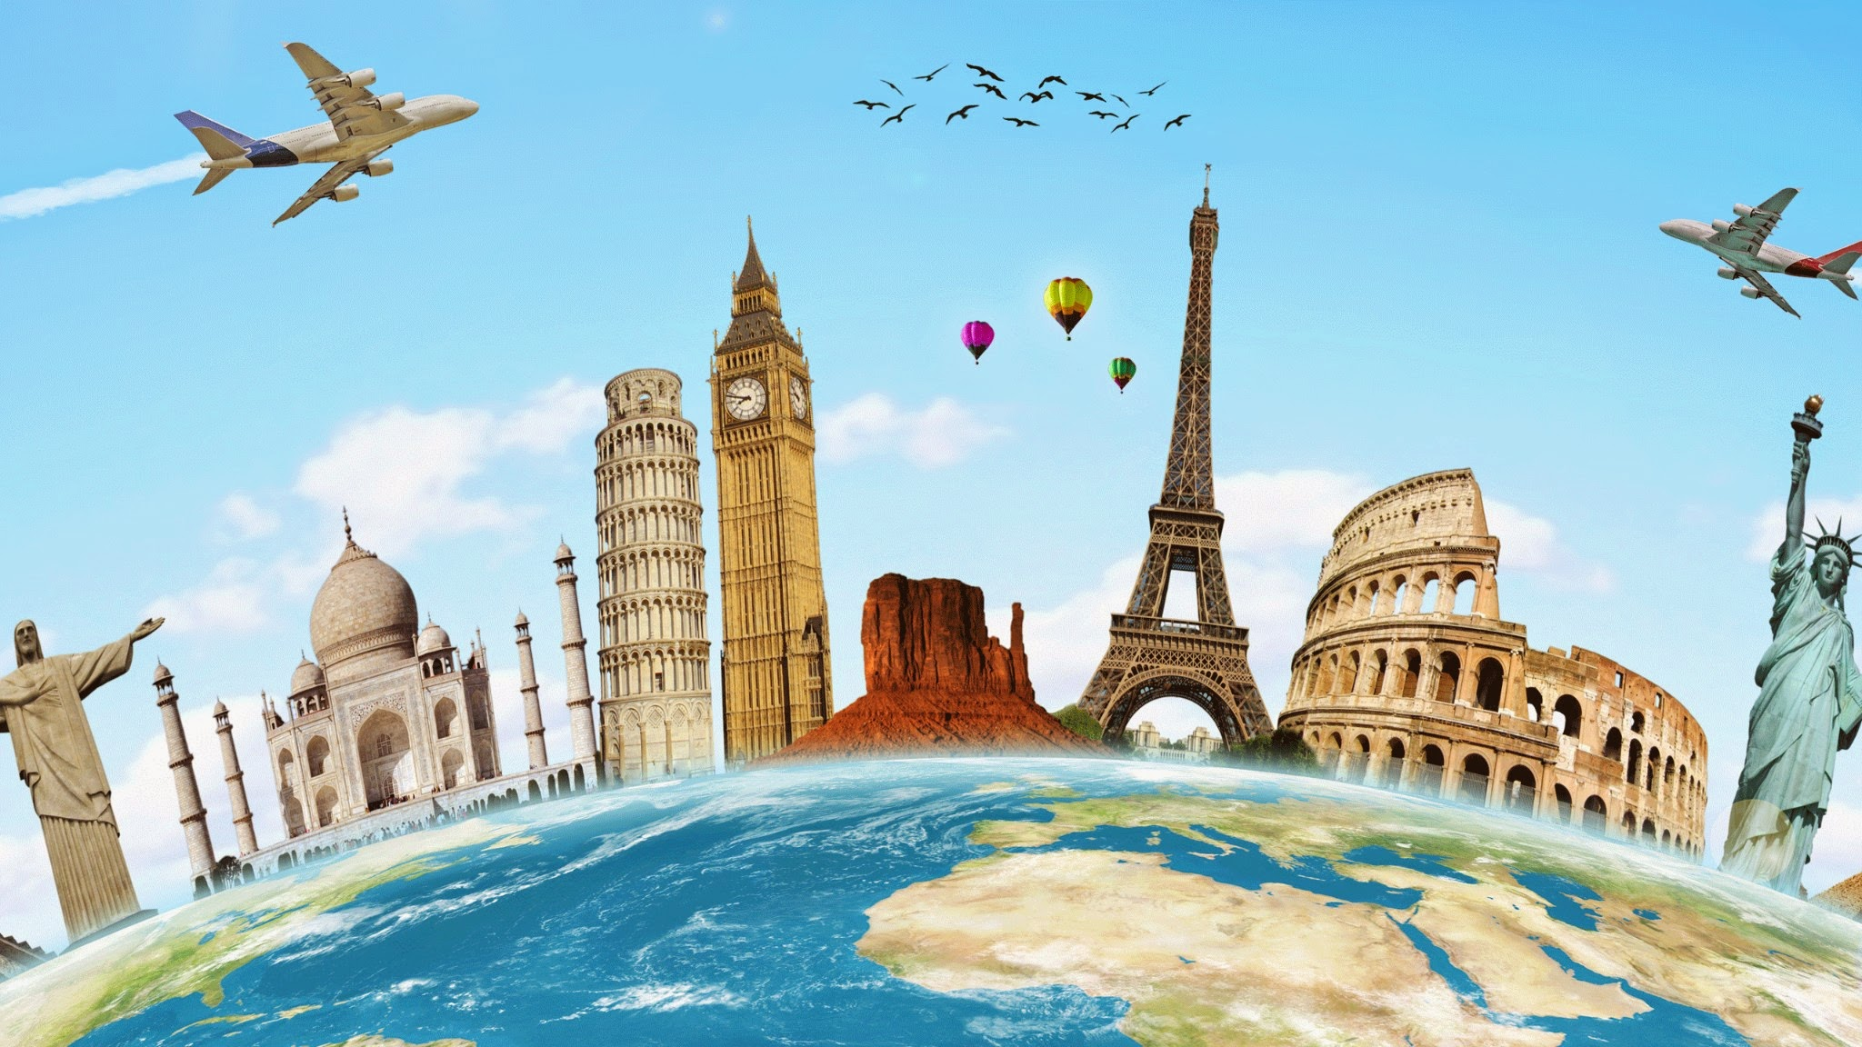
14. Travelling

Slide 3
14. Travelling
1. Have you ever been abroad?
2. Where have you been?
3. Are you planning on going anywhere for your next vacation?
If so, where?
Who with?
How long will you stay?
4. Are you afraid of going abroad alone?
5.Could you live in another country for the rest of your life?
6.Describe the most interesting person you met on one of your travels.
7. What was your best trip?
8. What was your worst trip?
9.Did your class in high school go on a trip together?
If so, where did you go?
How long did you stay?
How did you get there?

Slide 4
14. Travelling
10. Do you like to travel with children? Why or why not?
11. Do you like to travel with your mother? Why or why not?
12. Do you prefer summer vacations or winter vacations?
13. Do you prefer to travel alone or in a group? Why?
14. Do you prefer to travel by train, bus, plane or ship?
15. Do you prefer traveling by car or by plane?
16. Have you ever been in a difficult situation while traveling?
17. Have you ever been on an airplane?
How many times?
What airlines have you flown with?
18.Have you ever been to a foreign country?
19. Have you ever gotten lost while traveling? If so, tell me about it.

Slide 5
14. Travelling
20. Have you ever hitchhiked? If so, how many times?
21. Have you ever taken a package tour?
22. How do you spend your time when you are on holiday and the weather is bad?
23. How many countries have you been to?
24. How many times have you traveled abroad?
25. How much luggage do you usually carry?
26. If you traveled to South America, what countries would like to visit?
27. If you went to ___(Insert a country name)__, what kind of souvenirs would you buy?
28. If you were going on a camping trip for a week, what 10 things would you bring? Explain why.
29.What are some countries that you would never visit? Why would you not visit them?
30. What are some things that you always take with you on a trip?
31. What countries would you like to visit? Why?
32. What countries would you most like to visit?
In view of covid 19 situation, do you think it is a good idea to travel from one country to another or not?
On long flights do you usually walk around the plane to avoid health problems?
Has the airline ever lost your luggage? What happened?

Slide 6
14. Travelling
Vocabulary
Travel change location
Roam move about aimlessly or without any destination
Move change location
Step the act of changing location by raising the foot and setting it down
flytravel through the air; be airborne
Journey the act of traveling from one place to another
Voyage a journey to some distant place
Tour a route all the way around a particular place or area

Slide 7
14. Travelling
Vocabulary
9. Trek any long and difficult trip
mapa diagrammatic representation of the earth's surface
guidesomeone employed to conduct others
destinationthe place designated as the end, as of a race or journey
globetrottersomeone who travels widely and often

Slide 8
14. Travelling
Common English idioms for travelling:
1. To travel/ pack light
When someone says they need to pack or travel light, it means they can’t bring a lot of things with them on their trip.
For example: “I’m only going to the south for the weekend, so I have to pack light”.
2. To hit the road
To hit the road means to start a journey or to leave. It can also be used in normal, daily life when you decide it’s time for you to go home .
For example: “We have to be there by 10 am, so we’re hitting the road early tomorrow” or “I’ve been here long enough, it’s time I hit the road”.
3. To catch the sun
This idiom can be used whenever you go to the beach and someone gets sunburnt , so if you know anyone who gets burnt easily don’t miss the opportunity to use it with them!
For example: “Be careful you don’t catch too much sun at the beach, remember to put on some sunscreen!”
4. To live it up
Whenever you are having a really good time and enjoying your holiday , without worrying about anything (not even about money) you can use this idiom.
For example: “We’re really going to live it up in Las Vegas next month!”
5. On a shoestring/ on the cheap
This idiom is the complete opposite of the previous one. To do something on a shoestring or on the cheap, it means that you are doing it without spending a lot of money .
For example: “I’m going to travel around Europe on a shoestring. I’ll be staying at hostels and buying food in supermarkets”

Slide 9
14. Travelling
Common English idioms for travelling:
6. At the crack of dawn
To do something at the crack of dawn means that you’re doing it just as the sun is rising . It means you’re doing it at the earliest possible time.
For example: “The plane leaves at 7.30 am, so we have to get up at the crack of dawn to get to the airport on time”.
7. To call it a day/ night
When someone calls it a day or a night, it means that they stop doing anything else for the rest of the day, or that they finish what they’re doing and go to bed .
For example: “We went sightseeing in Rome, but we ended up feeling so exhausted that we called it a day and went back to the hotel”.
8. Off the beaten track
If a place or something is off the beaten track, it means that it is far away from where many people live, or in a remote location .
For example: “I want to stay on this island all summer because it’s off the beaten track, so there’s not many people here and it’s quiet and peaceful.”
9. To catch the red-eye
When a person says they have to catch the red-eye it means they have to take a plane which is leaving very late at night .
For example: “I have to sleep during the day as I’m catching a red-eye tonight”.
10. To live out of a suitcase
means that a person stays in many different places for only a short period of time, and with only enough things to put in a suitcase .
For example: “My cousin has been living out of a suitcase for years, her mother wishes she would settle down already”.
11. Break the journey
When someone breaks the journey, it means they decide to stop somewhere for a while during a long journey .
For example: “Our journey was so long that we decided to break the journey in a few places so we could rest for some days”.

